Slide 1
Testing contextuality on a general-purpose single-photon-based quantum computing platform
Shane Mansfield
arXiv:2306.00874, arXiv:2301.03536
Workshop on Samson’s Springer Volume
UCL, 18th Sep 2023

Slide 2


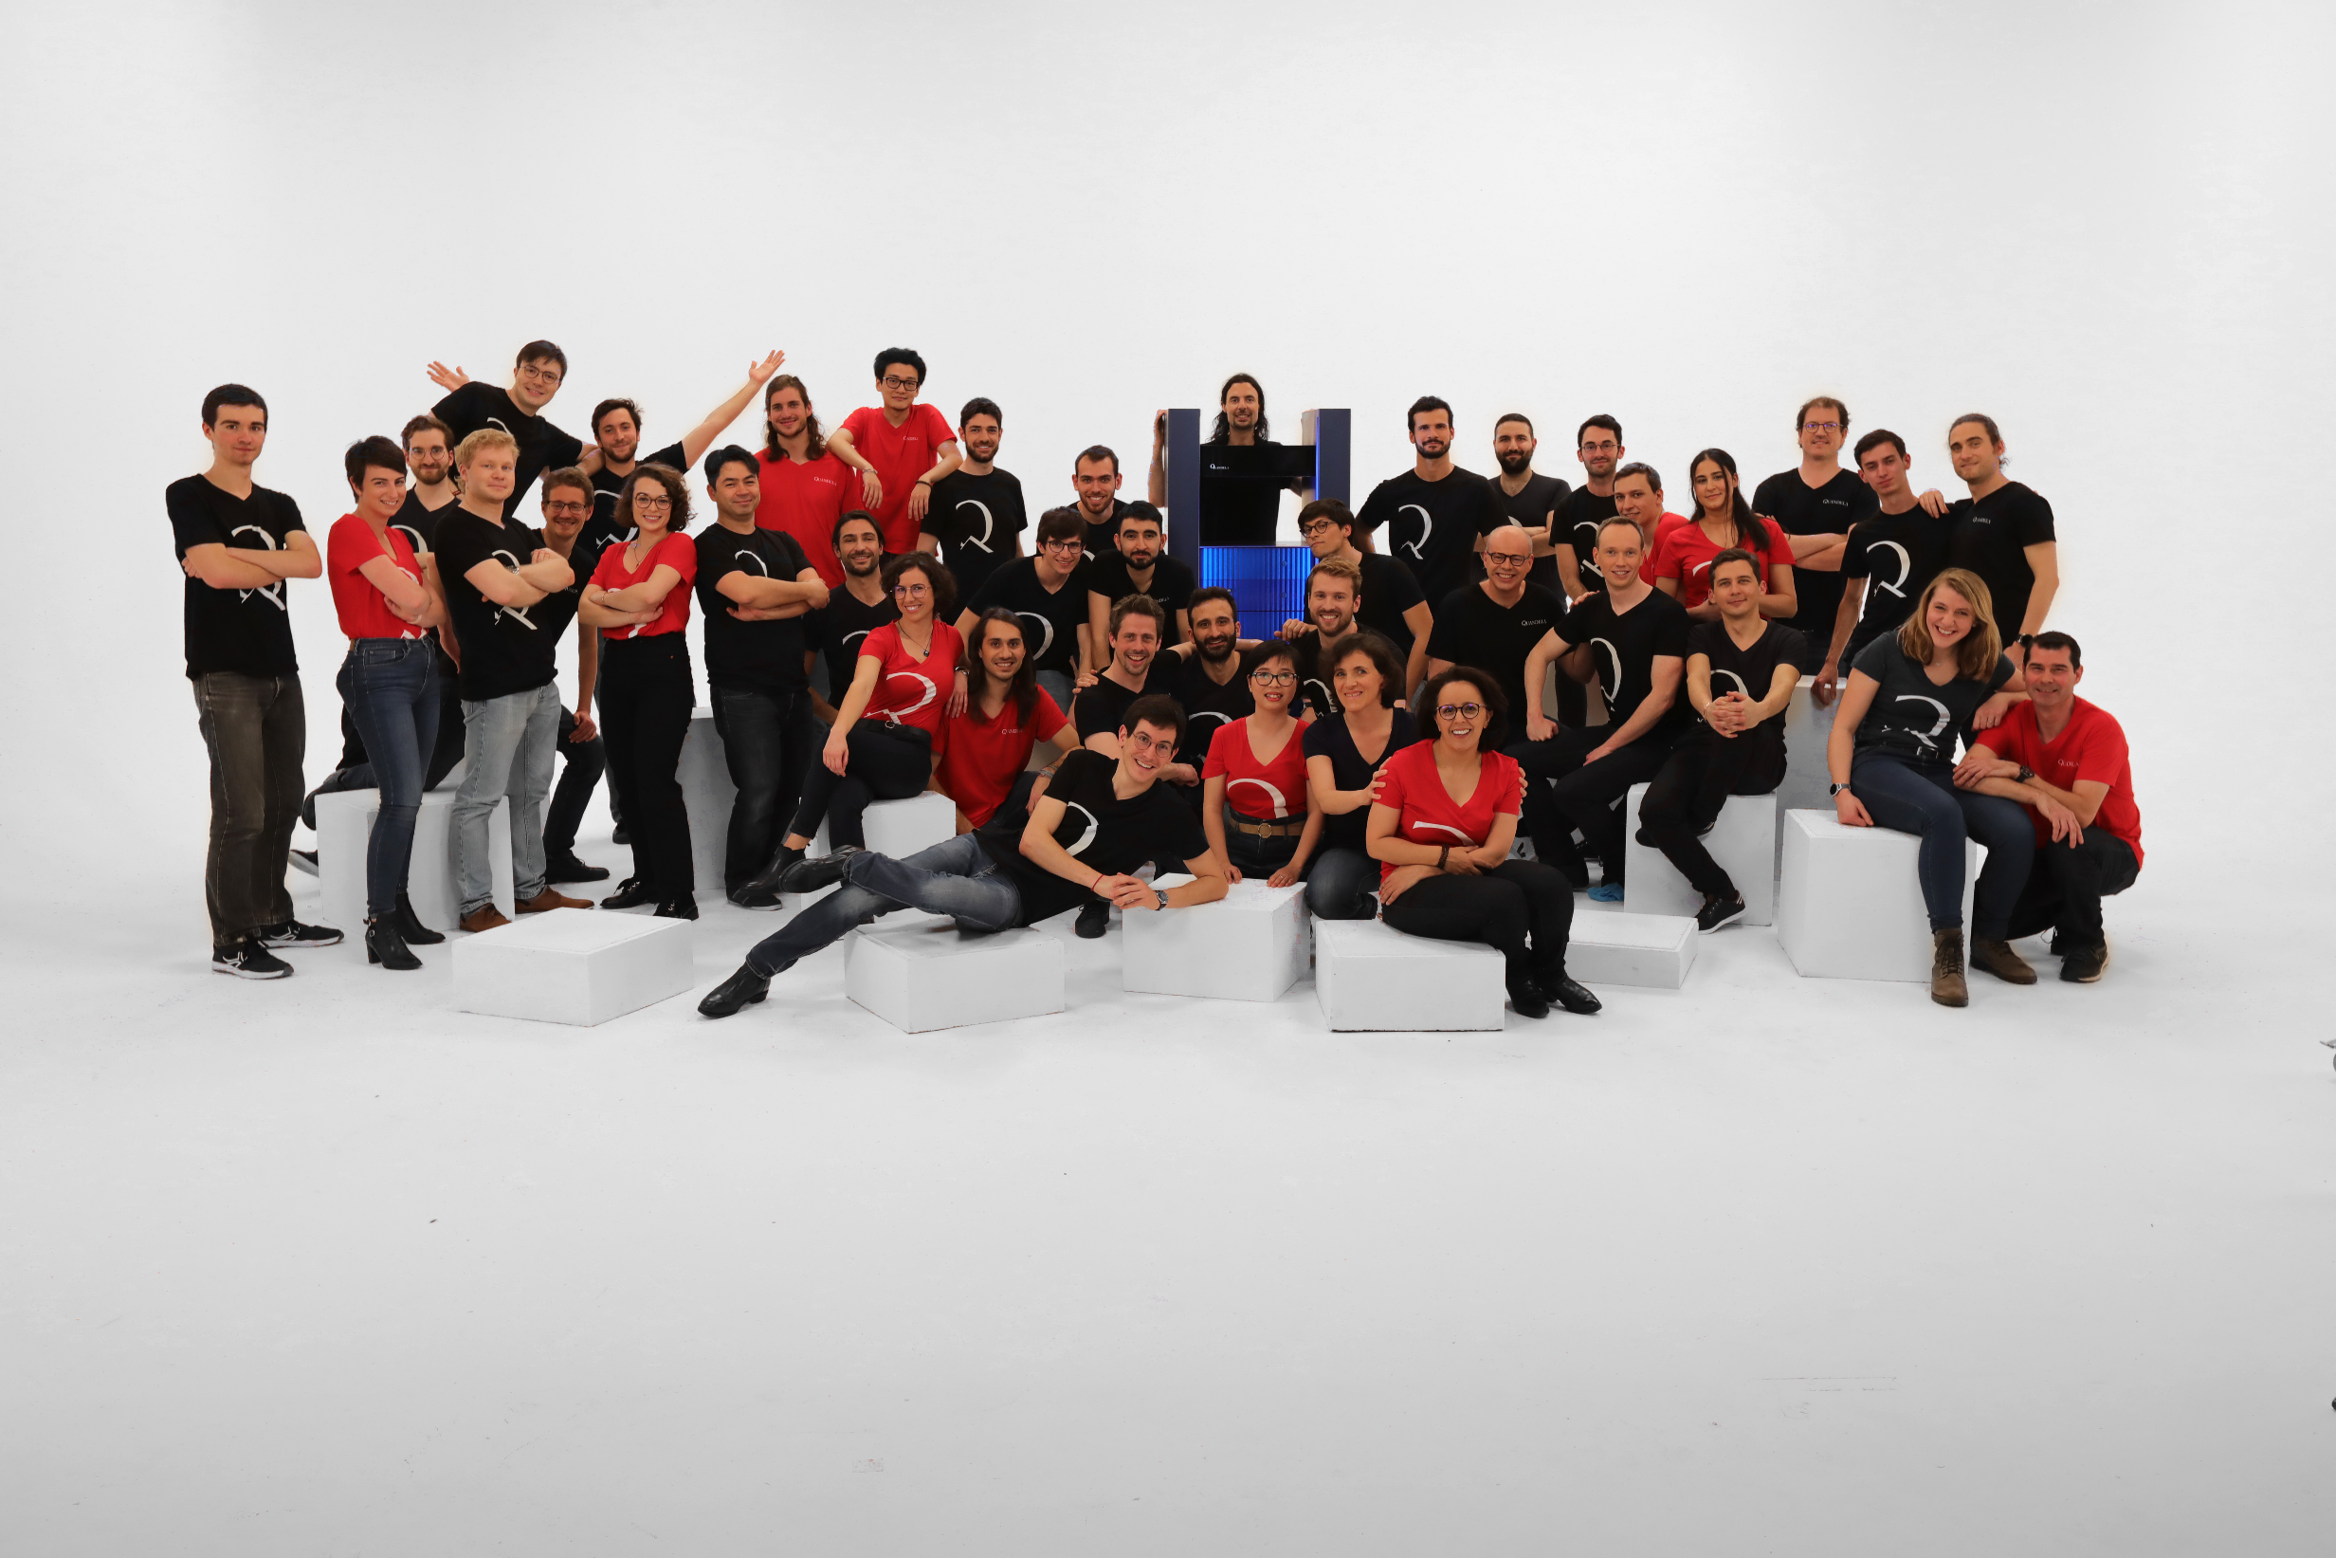
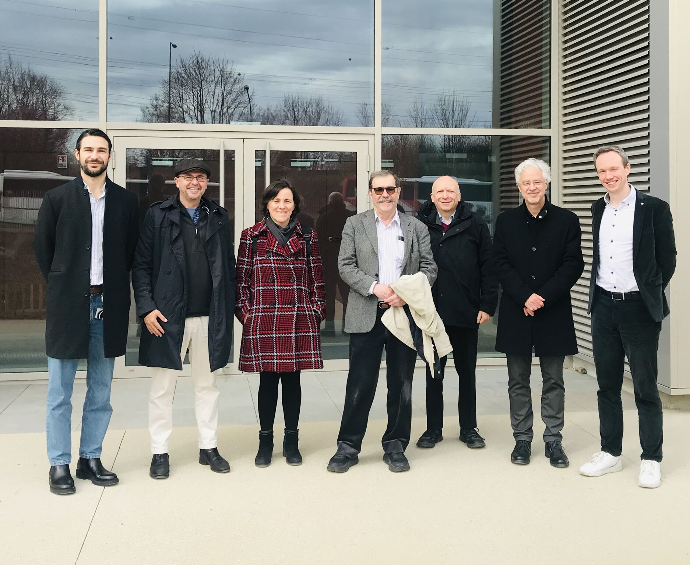





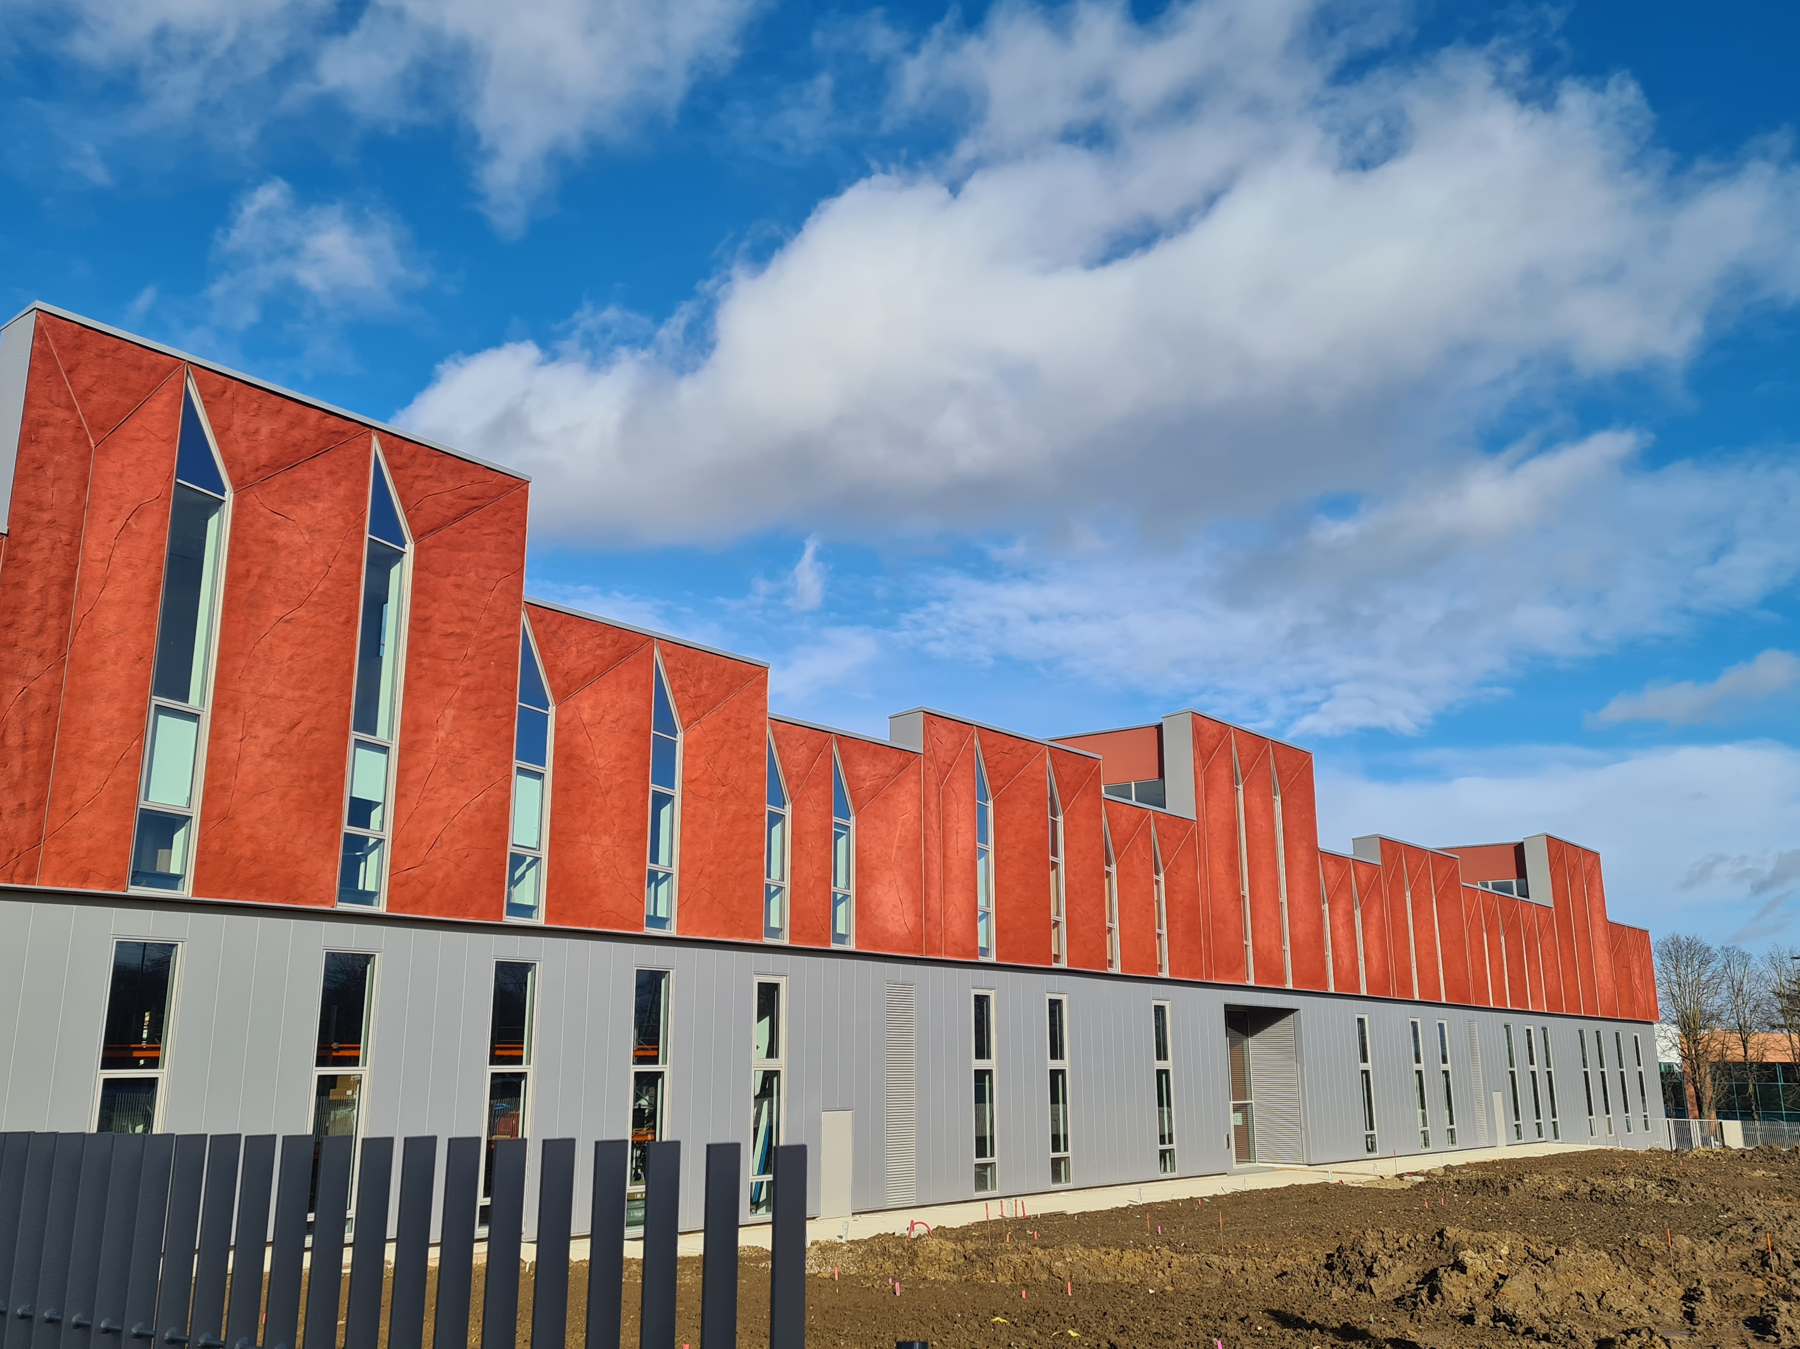


Quandela
Presentation
Quandela Scientific Advisory Board
Founded in 2017
>80 People
>50 Scientists and Engineers
algorithms, semiconductors, optical technologies, CS
R&D Centers
Production Centers
Paris-Saclay
Munich
Barcelona
C2N - Palaiseau
Massy
IPVF - Palaiseau
Massy

Slide 3
Ascella Quantum Processor

Slide 4
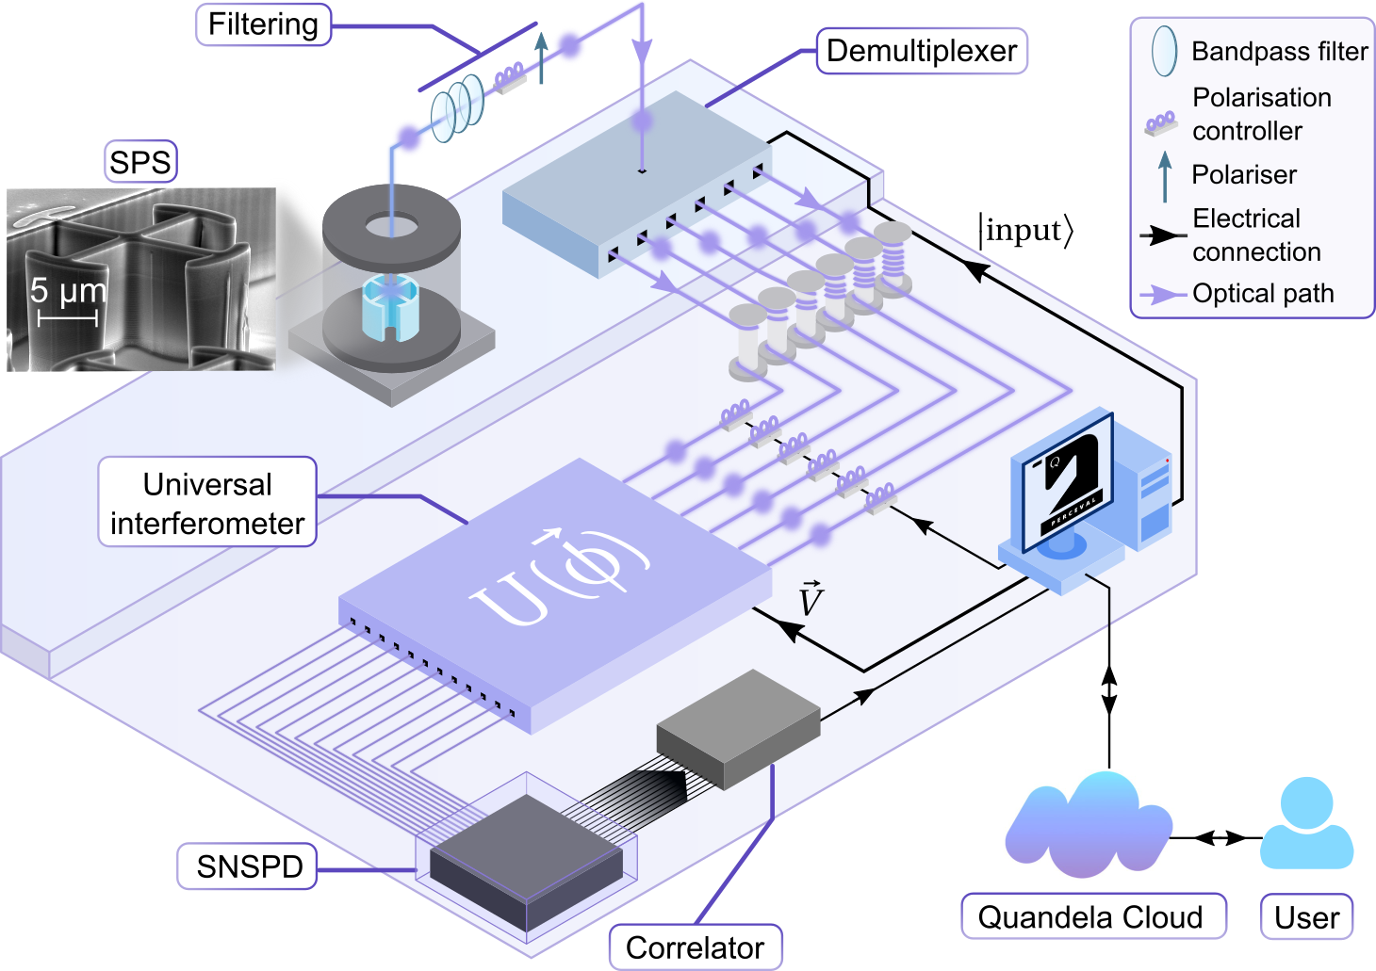
Ascella
Quantum Computing Platform
arXiv:2306.00874

Slide 5
Virtual Lab Tour
The Photon Source
18 x (λ/4 + λ/2)

Slide 6
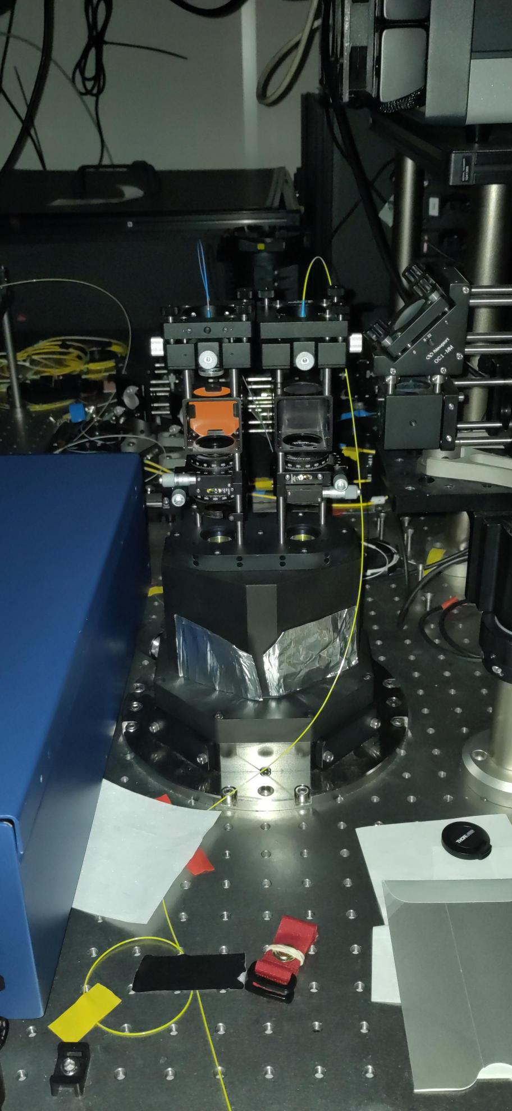
Virtual Lab Tour
The Photon Source
18 x (λ/4 + λ/2)

Slide 7
Virtual Lab Tour
Filtering

Slide 8
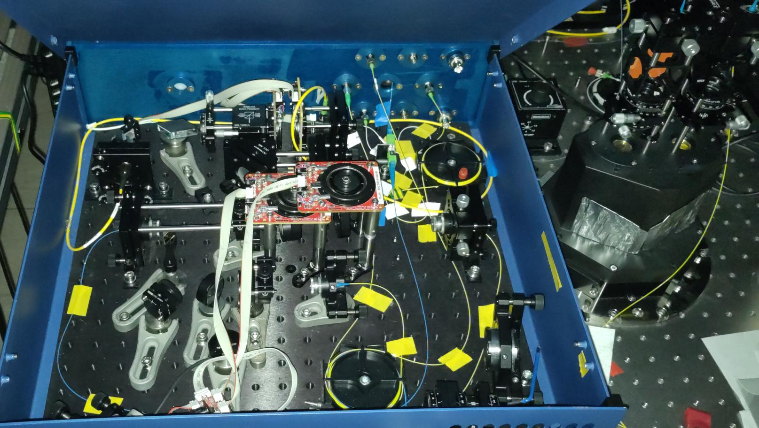
Virtual Lab Tour
Filtering

Slide 9
Virtual Lab Tour
Demultiplexer

Slide 10
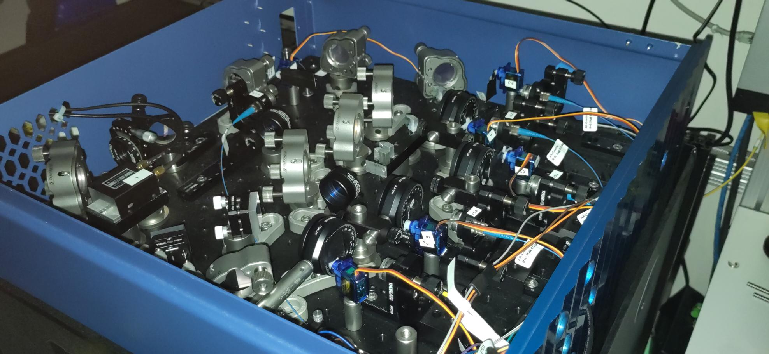
Virtual Lab Tour
Demultiplexer

Slide 11
Virtual Lab Tour
Photonic Circuit

Slide 12
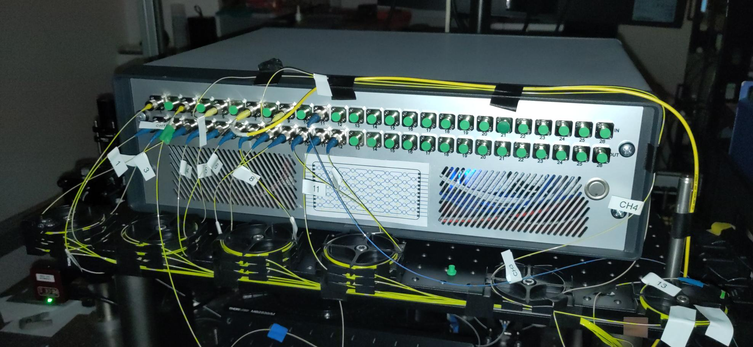
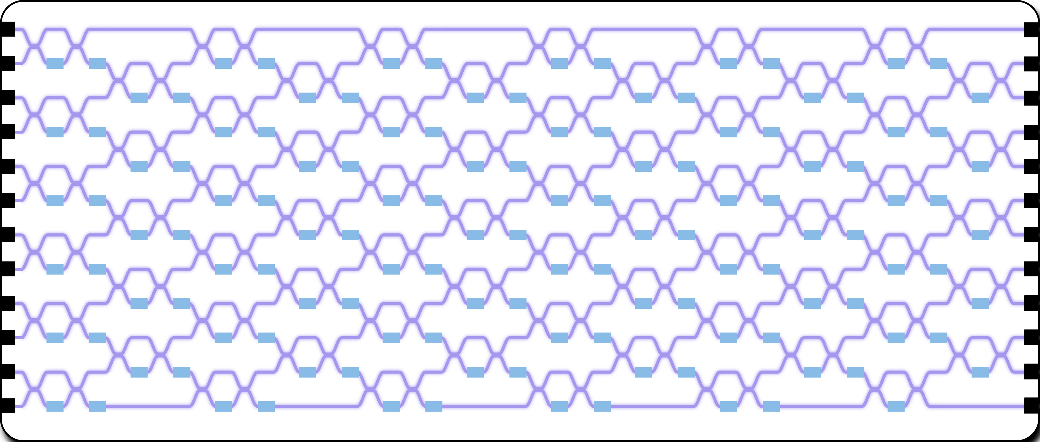
Virtual Lab Tour
Photonic Circuit
12 x 12 fully reconfigurable universal interferometer

Slide 13
Some Notions of Photonic Quantum Computing

Slide 14
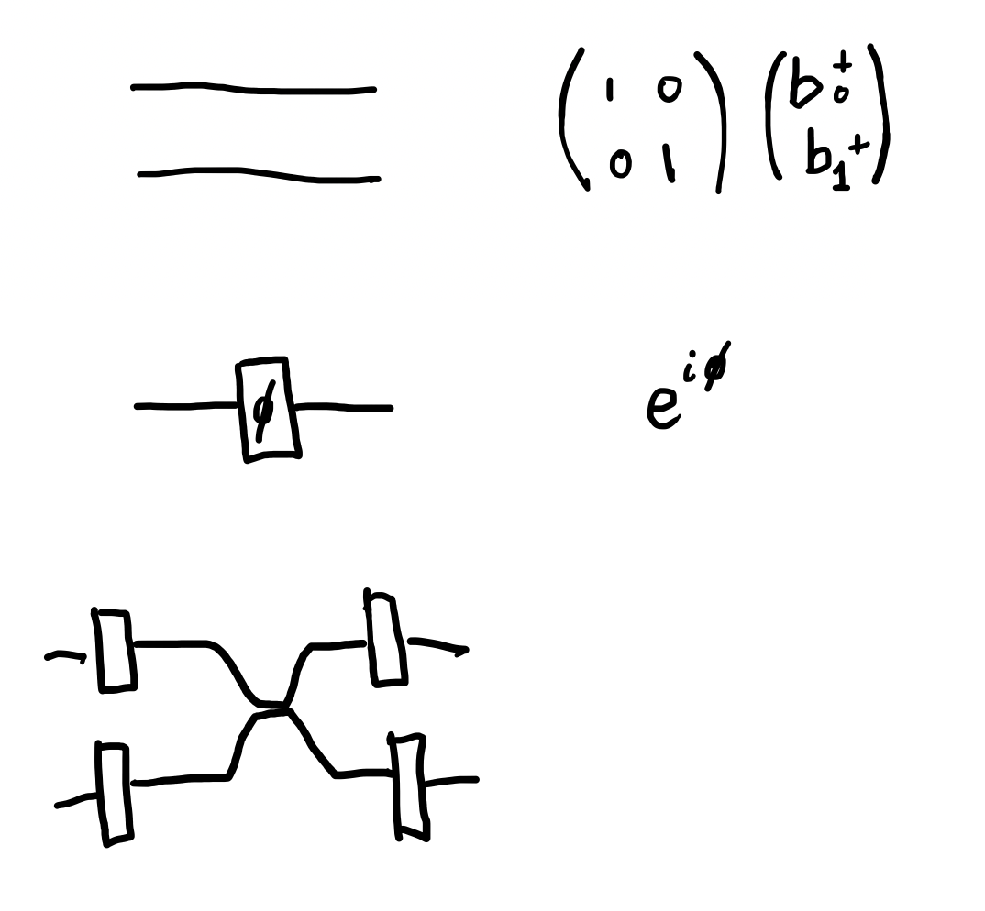
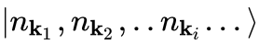
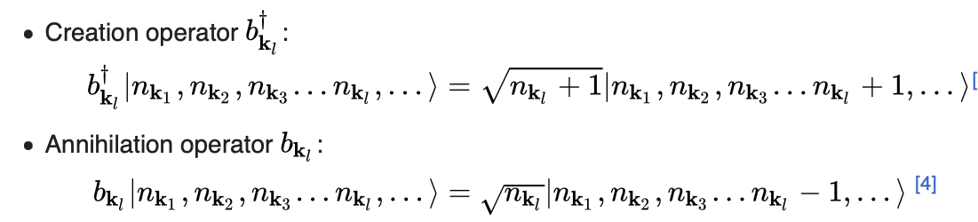
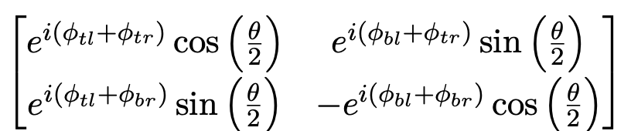
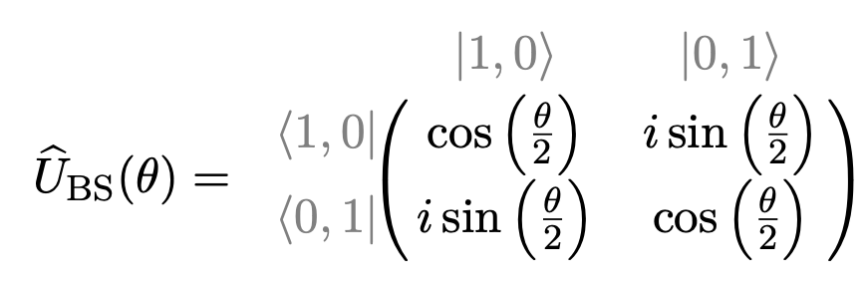
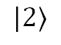
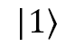
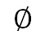
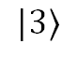
Photonic Operations
Second Quantisation Description
Fock state with n_{ki} photons in mode k_{i}
Identity on 2 modes
Phase shift
Beam splitter
b†
b†
b†
General
$$∅$$
$$|1⟩$$
$$|2⟩$$
$$|3⟩$$
…
No phases
b
b
b
b

Slide 15
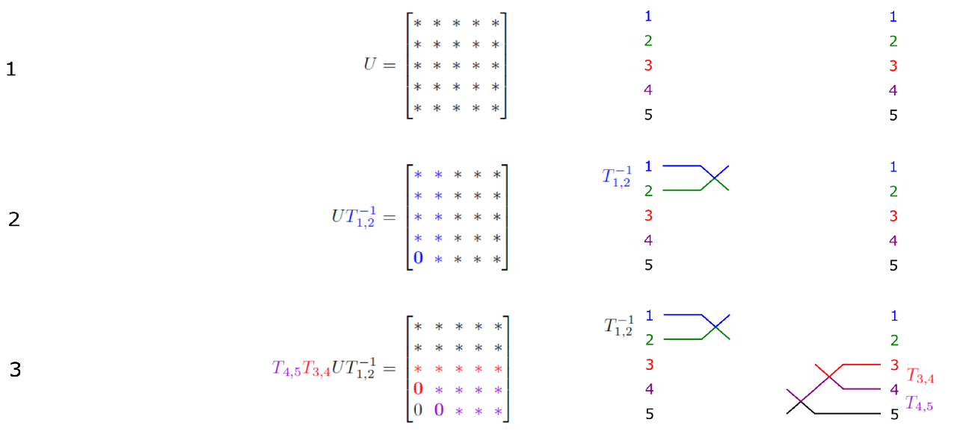
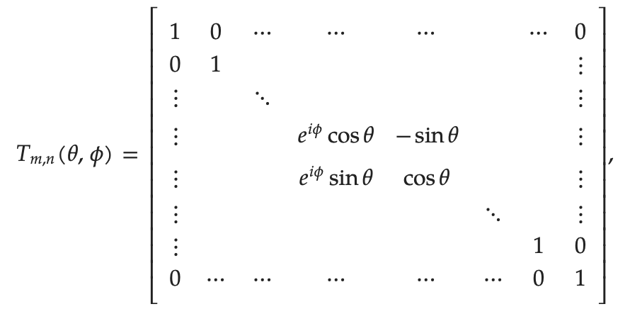
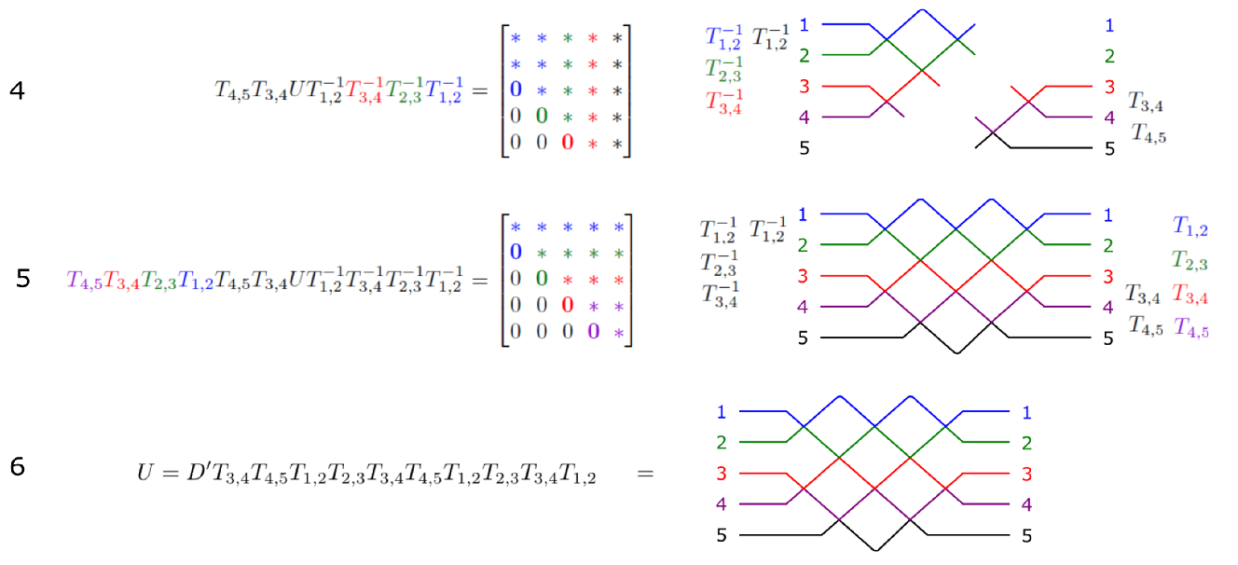
Universal interferometer
Linear Optical Implementation of an Arbitrary Unitary via Normal Form
Clements, William R., et al. "Optimal design for universal multiport interferometers." Optica 3.12 (2016): 1460-1465.
Based on an earlier work:
Reck, Michael, et al. "Experimental realization of any discrete unitary operator." Physical review letters 73.1 (1994): 58.

Slide 16
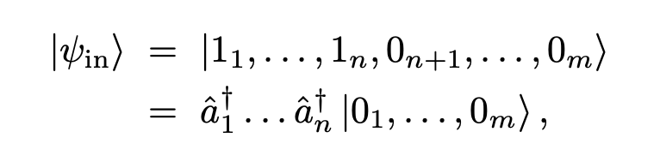
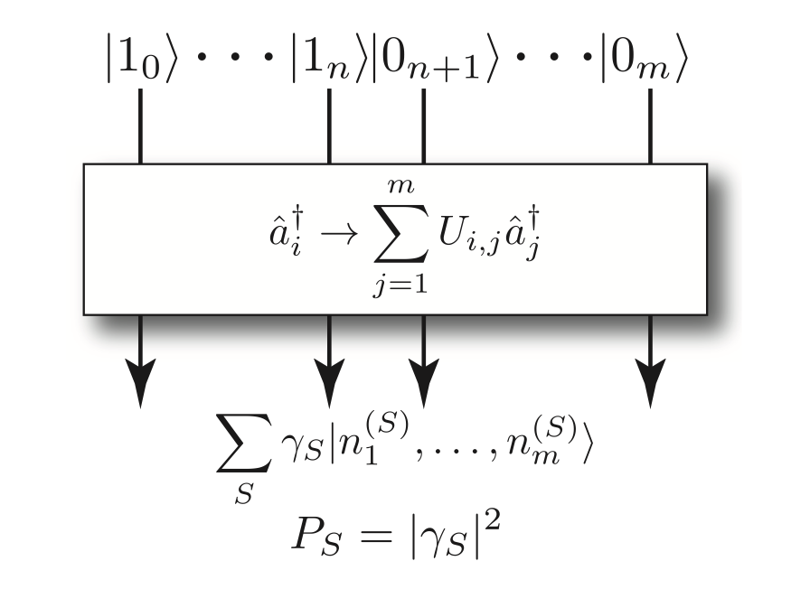
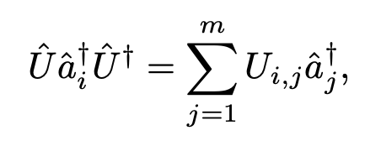
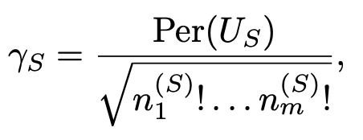
Boson Sampling
Linear Optics is #P-hard to Exactly Simulate
Gard, Bryan T., et al. "An introduction to boson-sampling." From atomic to mesoscale: The role of quantum coherence in systems of various complexities. 2015. 167-192.

Slide 17
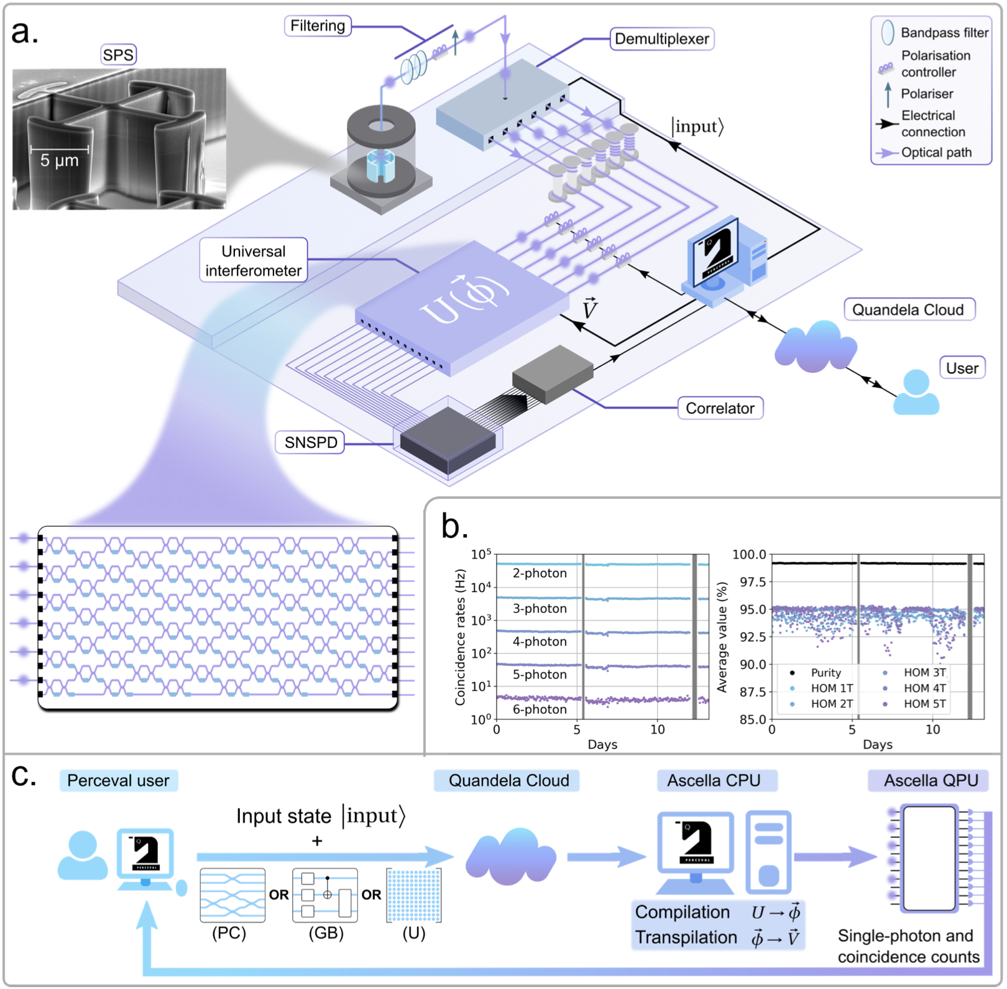
Ascella
With Universal Interferometer
User input
Fock state
Unitary / Photonic Circuit (PC) / Gate-based Quantum Circuit (GB)
PC and GB can first be compiled to a unitary
User output
Coincidence counts

Slide 18
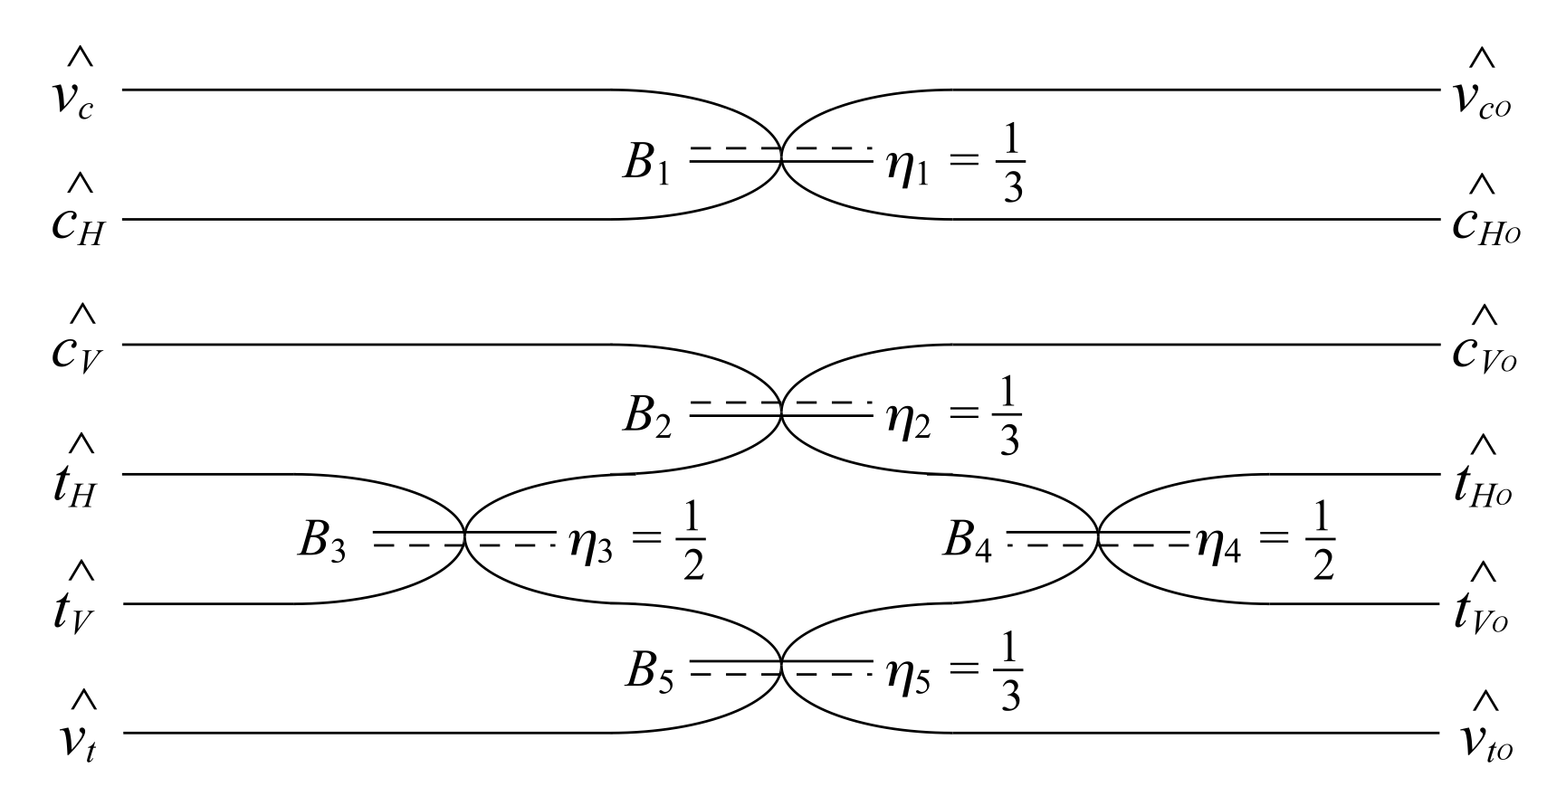
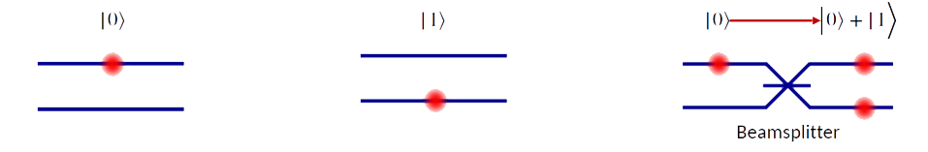
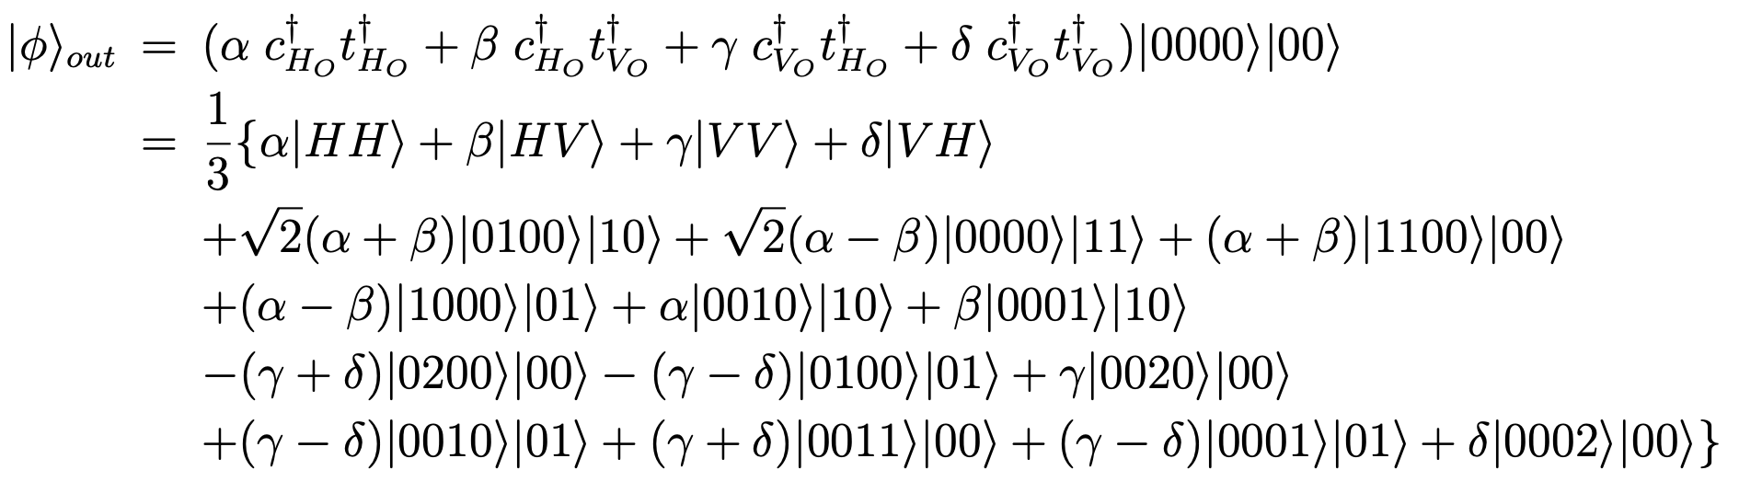
Qubits & Logic Gates
Postselection, Heralding and Active Linear Optics
Dual-rail Qubit Encoding
one-qubit gate
Basic Example: Postselected CNOT
Photon
|0>
|1>
But 2-qubit gates cannot be achieved deterministically with passive linear optics
Requires:
Nonlinearities (materials unavailable)
Postselection (probabilistic)
Heralding (probabilistic)
Feedforward
Ralph, Timothy C., et al. "Linear optical controlled-NOT gate in the coincidence basis." Physical Review A 65.6 (2002): 062324.

Slide 19
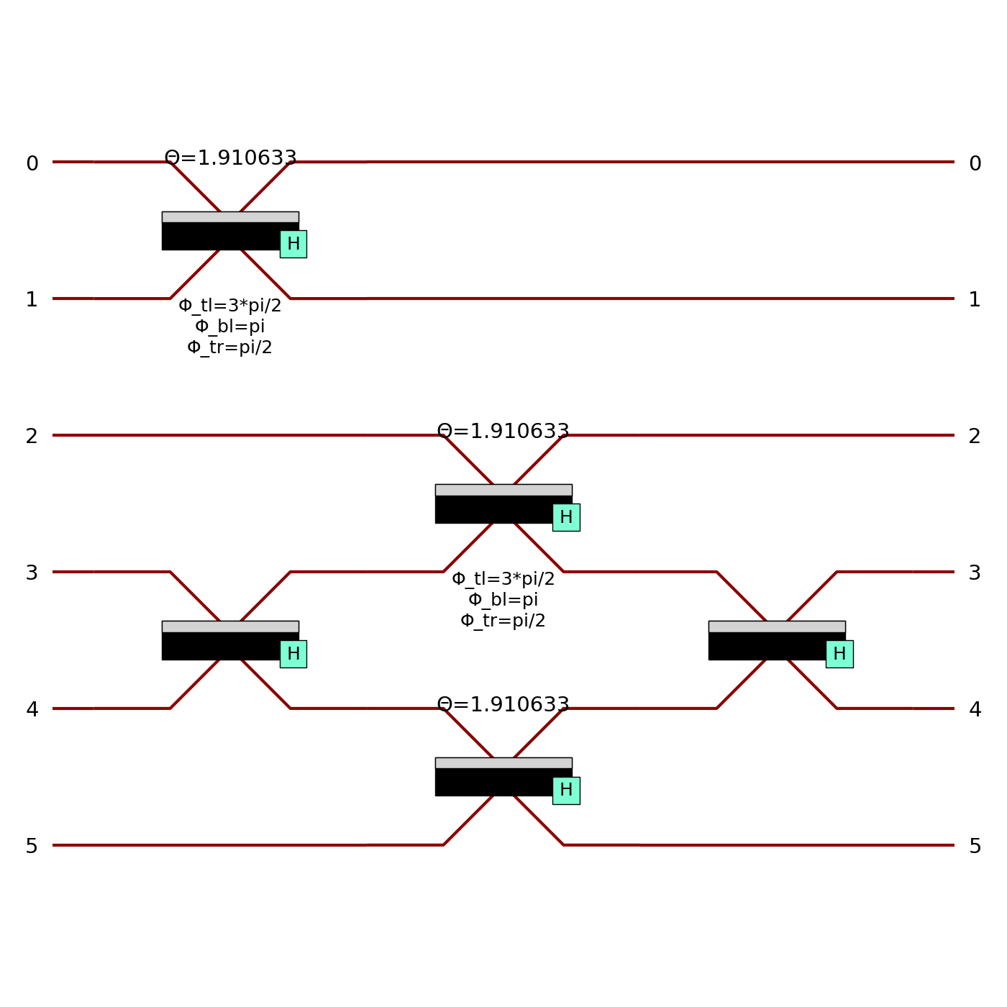
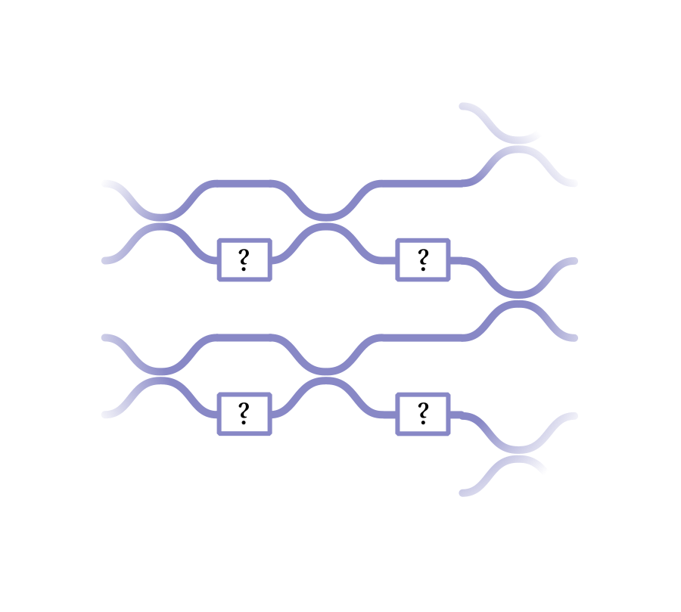

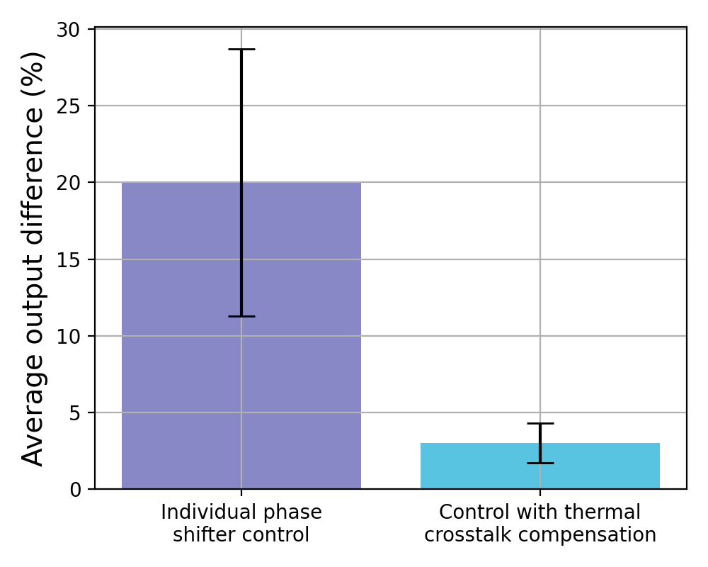

Ascella: Compilation & Transpilation
With Machine Learning to Offset Hardware Imperfections
$$\hat{U}$$
Circuit
Unitary matrix
Phases
Voltages
Compilation
Transpilation
12 x 12 fully reconfigurable universal interferometer
126 physical phase shifters
132 directional couplers
Standard approach
Machine learning

Slide 20
Testing Contextuality

Slide 21
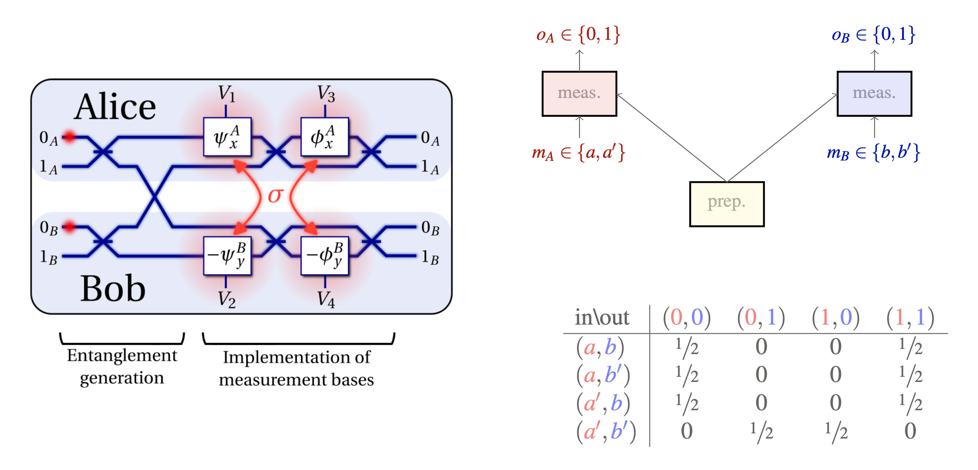
Bell-CHSH Scenario
A Contextuality Test
Not the actual experimental data yet…

Slide 22
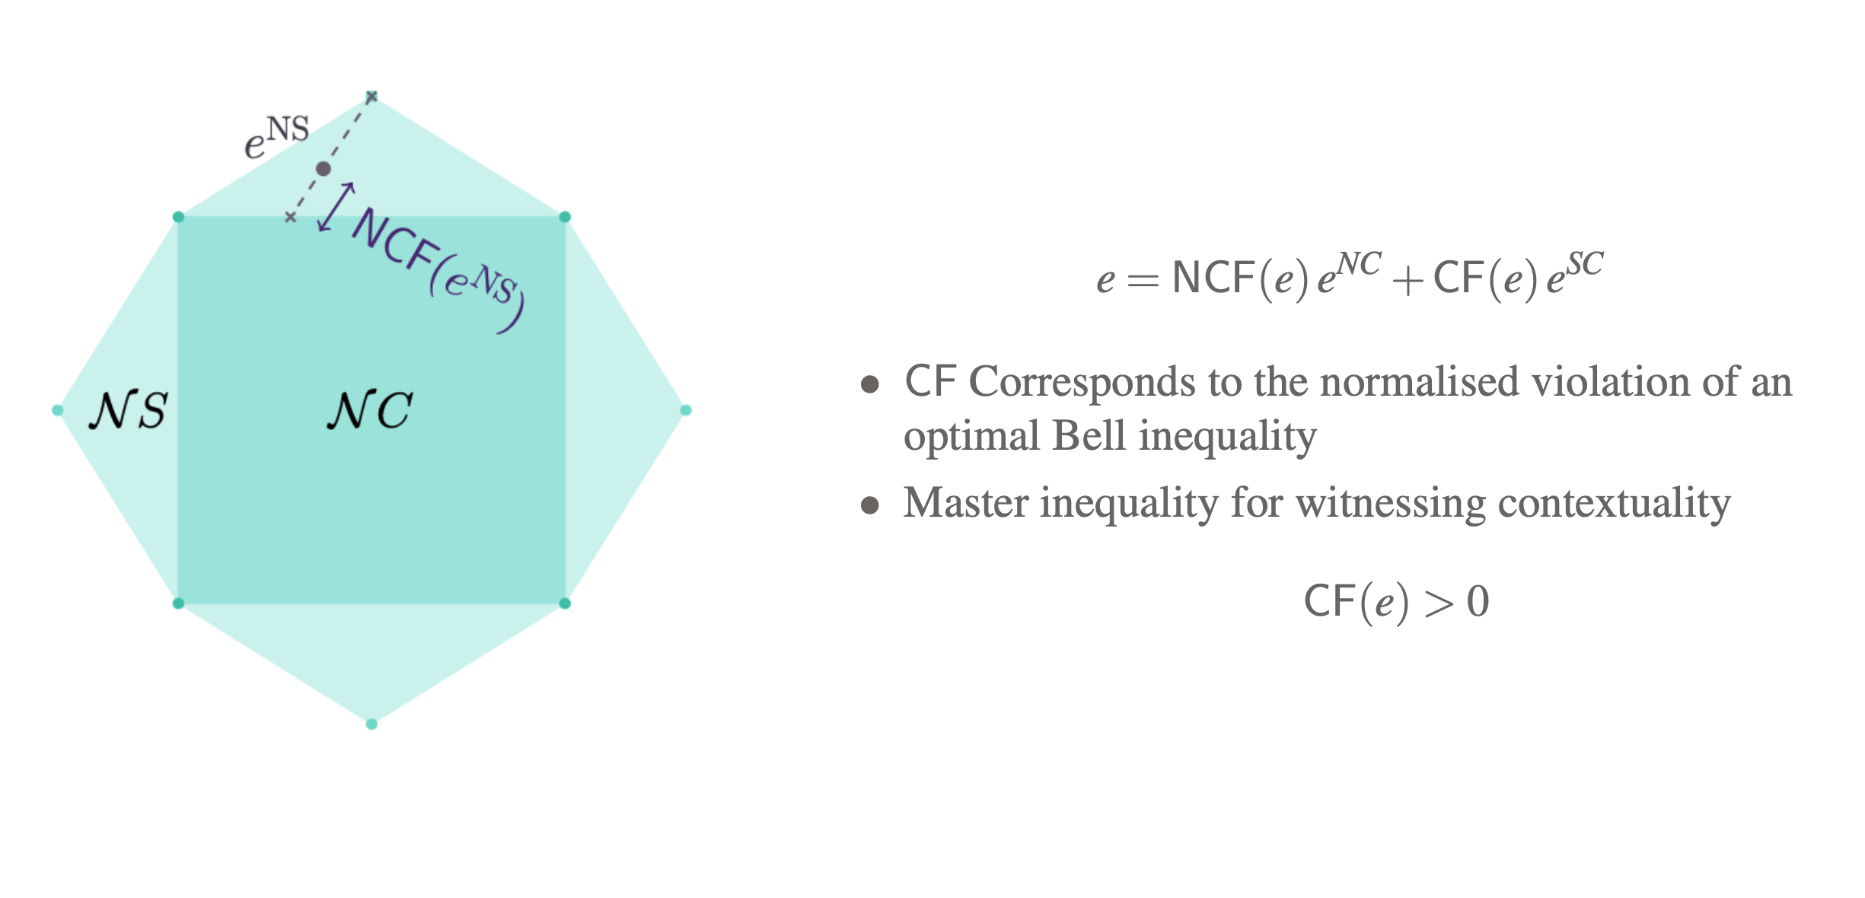
Quantifying Contextuality
Contextual Fraction
Abramsky, Samson, and Adam Brandenburger. "The sheaf-theoretic structure of non-locality and contextuality." New Journal of Physics 13.11 (2011): 113036.
Abramsky, Samson, Rui Soares Barbosa, and Shane Mansfield. "Contextual fraction as a measure of contextuality." Physical review letters 119.5 (2017): 050504

Slide 23
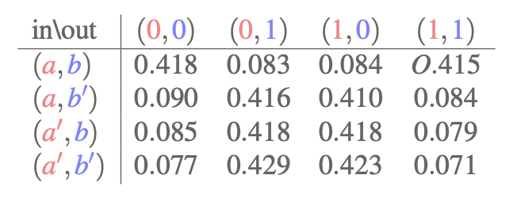
Quantifying Contextuality
On Actual Empirical Data
CF ≈ 0.34
Tsirelson bound: CF ≈ 0.41
Fyrillas et al., arXiv:2301.03536

Slide 24
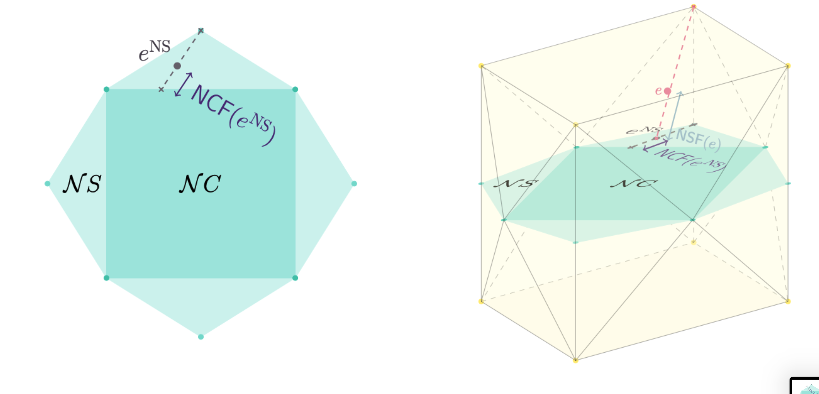
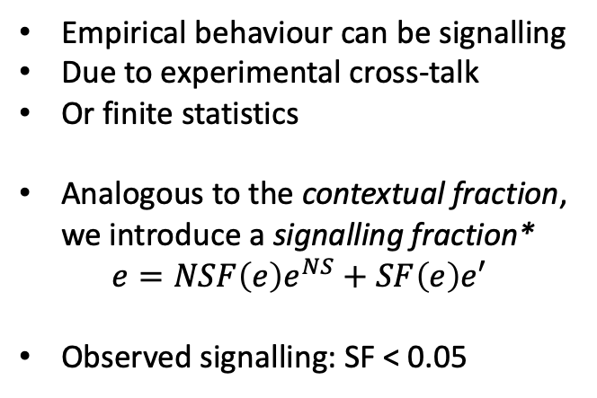
Non-ideal data
The Signalling Fraction
Empirical behaviour can be signalling
Due to experimental cross-talk
Or finite statistics
Analogous to the contextual fraction, we introduce a signalling fraction*
$$e=NSF\left(e\right)e^{NS}+SF\left(e\right)e′$$
Observed signalling: SF < 0.05
*From unpublished work with Samson and Rui

Slide 25
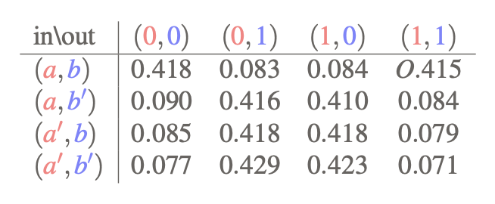
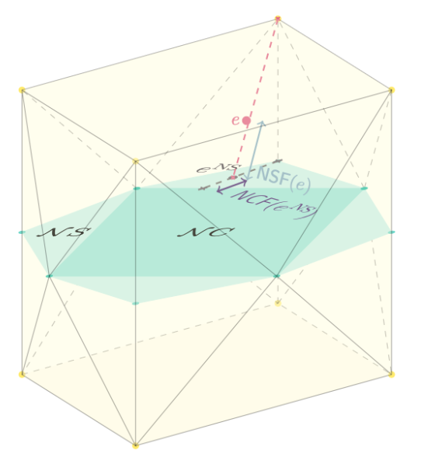
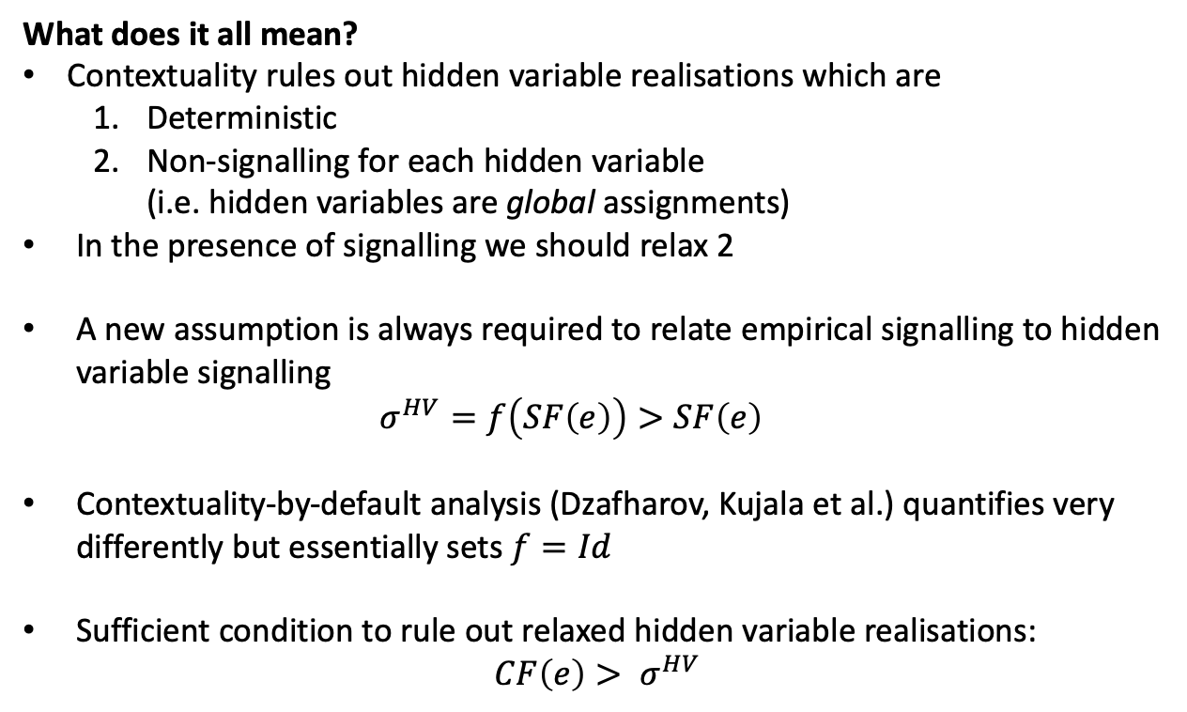
Contextuality in the Presence of Signalling
What does it all mean?
What does it all mean?
Contextuality rules out hidden variable realisations which are
Deterministic
Non-signalling for each hidden variable (i.e. hidden variables are global assignments)
In the presence of signalling we should relax 2
A new assumption is always required to relate empirical signalling to hidden variable signalling $σ^{HV}=f\left(SF\left(e\right)\right)>SF\left(e\right)$
Contextuality-by-default analysis (Dzafharov, Kujala et al.) quantifies very differently but essentially sets $f=Id$
Sufficient condition to rule out relaxed hidden variable realisations: $CF\left(e\right)> σ^{HV}$
Vallée, Kim et al. in preparation

Slide 26
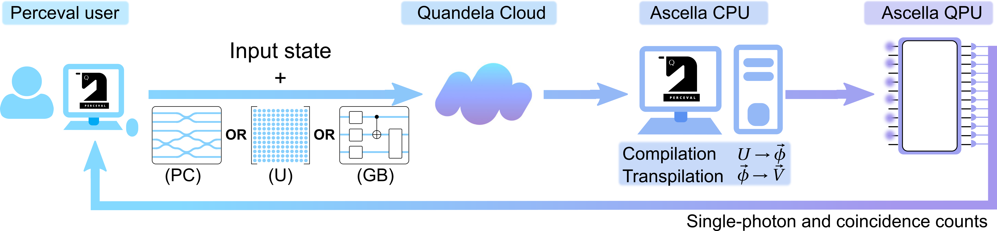


Experimenting with Ascella
Free access
https://perceval.quandela.net/
Quandela Scientific Advisory Board
https://cloud.quandela.com/

Slide 27
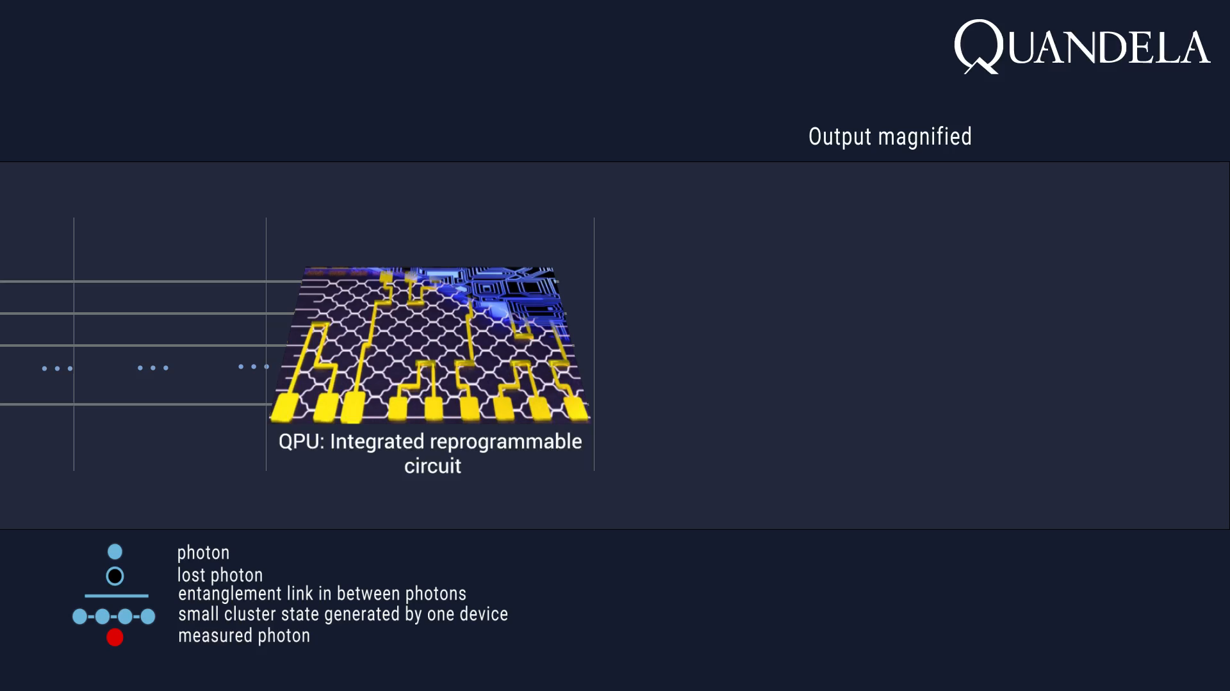
Scaling Photonic QC
Via Measurement Based QC
1
2
3
4
1D CLUSTERS
ASSEMBLY INTO 3D CLUSTERS
RENORMALISATION
ERROR CORR. CODE
C
Measurement layer
A
B
Generator of
cluster states¹
Manipulation
Continuous & Sequential generation
Time
Time
Time
“High-rate entanglement between a semiconductor spin and indistinguishable photons”: N. Coste, P. Senellart at al, arxiv2207.09881 - https://arxiv.org/abs/2207.098814
“Percolation thresholds for photonic quantum computing”: S. Ghua, NatCommunication, 10, 1070,2019 - https://www.nature.com/articles/s41467-019-08948-x
“Measurement-based quantum computation”: H. Briegel at al, Nature Physics, 5, 19,2009 - https://www.nature.com/articles/nphys1157

